Slide 1
PeerPresents with TEAM___?
“Team fill-in-the-blank”

Slide 2
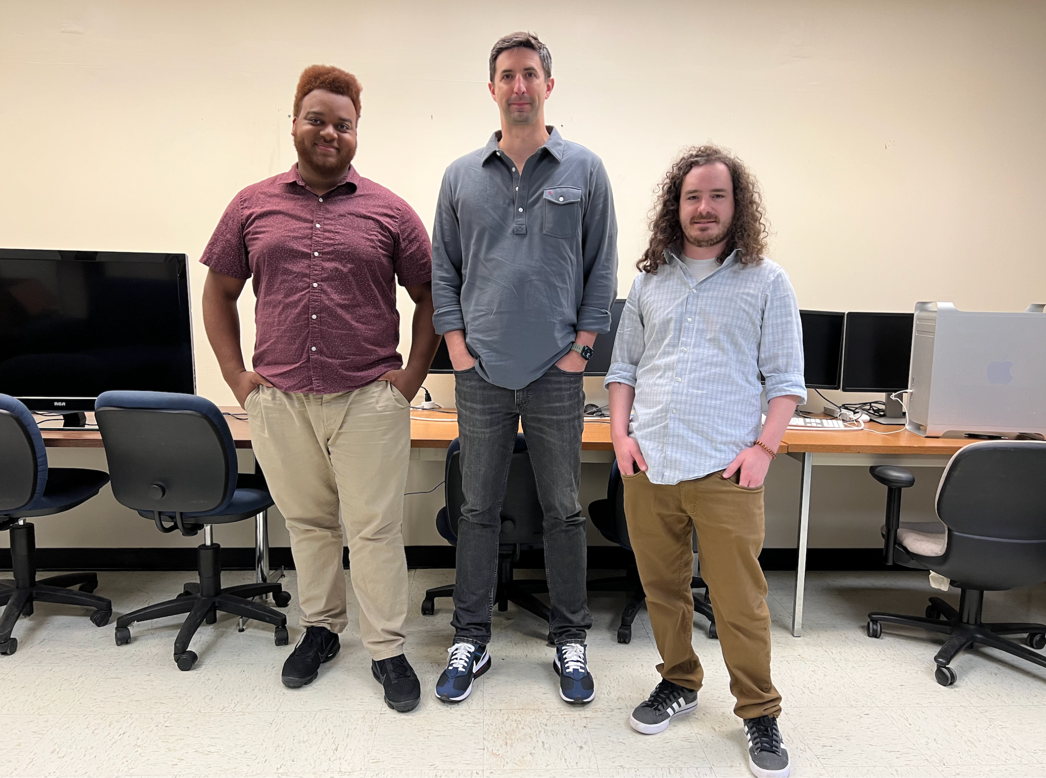
Andre Brumfield
Chris Smalley
Elliott Schwarzman

Slide 3
SUMMARIZATION
REFLECTION
CHANGES
Summarize their individual contribution to the project
Reflect on their experience (answer at least 3 questions)
What went well on your team? What didn't go well?
What surprised you about the capstone project experience?
What did you learn about computer science? What did you learn about teamwork?
Discuss a challenge that you encountered on this project, and how you overcame that challenge.
If you had a do-over, what would you do differently?

Slide 4
Initial Setup
We all had difficulties setting up project due to dependencies and unique system requirements.
I think if I were to do this project again, I would setup Ubuntu right away and run the project through that. Would have had similar setup and configurations as the rest of the group.

Slide 5
Y Axis
Modified the Y axis button to toggle between “total” and “average”.
Created an array to store the values of y from each object
Returned a ternary operator that if “true” displays “total” if “false” displays “average”

Slide 6
Hover and Bar Configuration
Hover:
Used an “events{[]}” feature to create a flyout that displays information for the bar. Able to display specific information about each bar on graph.
Bar Configuration:
Original setup had bars sliding off the page.
Fix: Added “domain{[0,5]}” in the VictoryAxis to limit the domain of the bars.

Slide 7
Data Type Selection, “Dataset Tree,” & Adding Graphs
Large cover charge but free re-entry
Constructing dataset
Helpers
Sprint4uSprint2me4meirl: late start for development
Optimization
Co-dependent tasks; interfacing with each other’s code
If it works, we commits
Generics
Unnecessary Overhead
getTeam()
Updating an Existing Project:
Functionality but not your functionality
Telephone: context loss over time
Documentation exists, you should read
It work(ed): library management & upkeep

Slide 8
Skills
Surprisingly NPM & Git
JavaScript
Async/Await
Destructuring
Closures, scope
Anonymous, Arrow functions
React
states
props
class and functional components
Improved debugging: stack traces, error logs
Markdown syntax

Slide 9
Reflections
What went well
No pushups: Communication, attention, patience
Suprise!
We laughed, we cried, we did it
TEAM___?
Gracious
What I need to work on
Challenge
DB Access: dev tools + dataset tree
Do-over
Commits, pushes & tasks
Linux

Slide 10
Data Tab Stability
Dependency issues haunted the group throughout development, resolution of Data page to be stable accessing tab.
Adjusted versions of peer dependencies!

Slide 11
Lessons
Less words better
Better sooner than later (asking edition)
Maintain your project dependencies
Teammates are people too
How to become a world heavyweight champion
Technical lessons:
Error logs & stack traces - general methodology, uncomfortably comfortable working through problems now
Developer toolkit - console tricks, variable and style editing, React Component tool

